Slide 1



Interactive Data Visualization
Visualiser le temps
http://romain.vuillemot.net/
Romain Vuillemot

Slide 2
Qu’est-ce que le temps ?
Notes:
http://vda.univie.ac.at/Teaching/Vis/15s/LectureNotes/15_TimeVis_Aigner.pdf

Slide 3
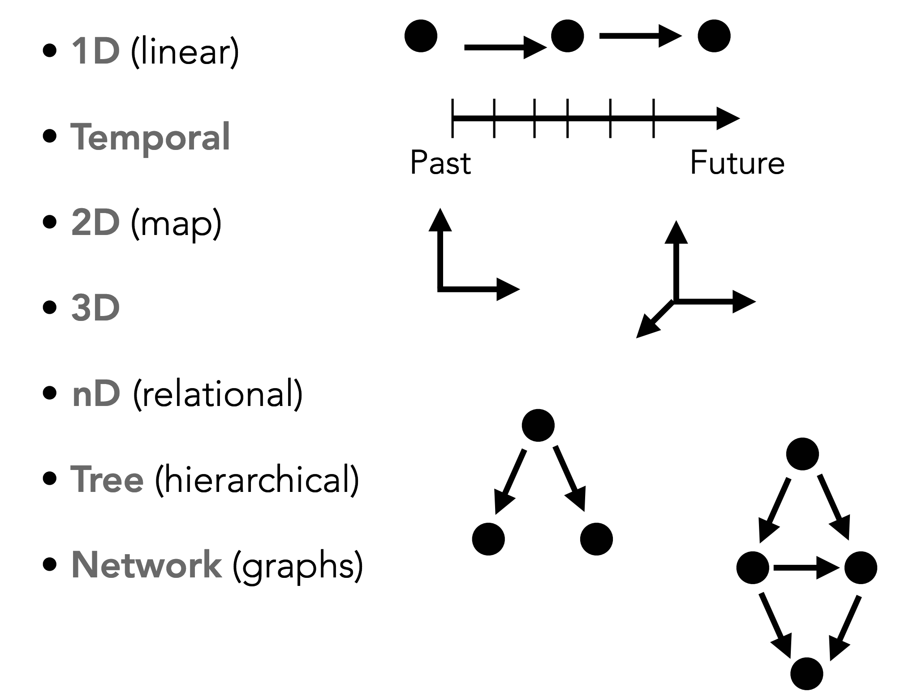
DATA TYPES
"Visualization Analysis and Design. Tamara Munzner, with illustrations by Eamonn Maguire. A K Peters Visualization Series, CRC Press, 2014."

Slide 4
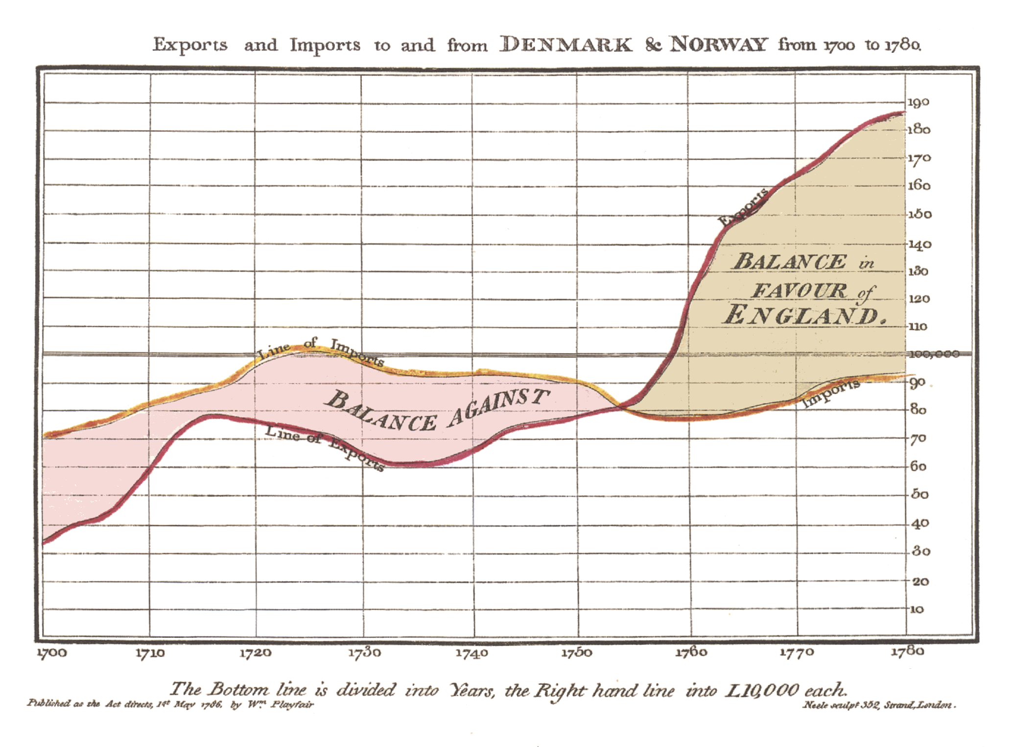

Slide 5
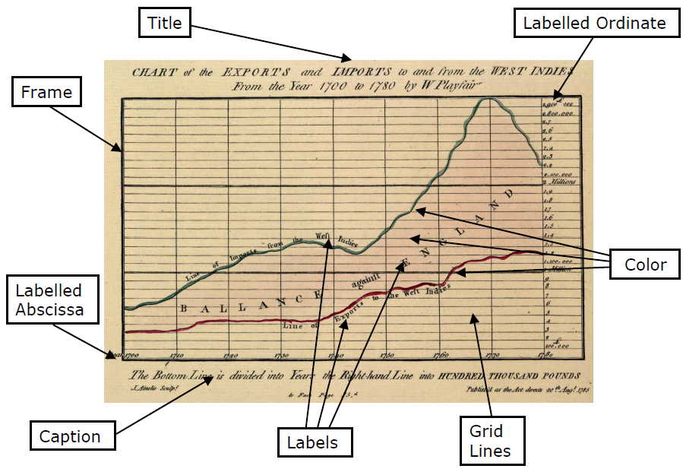

Slide 6
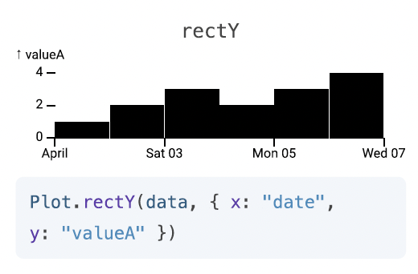
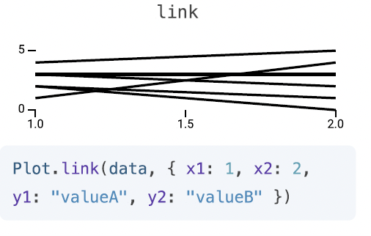
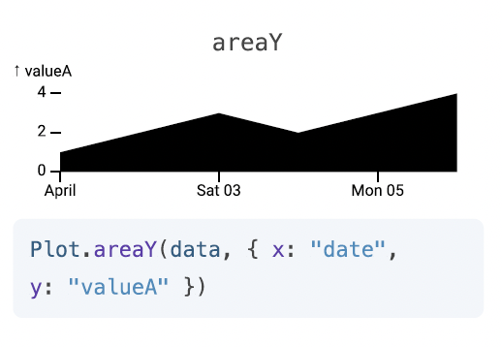
Comment visualiser le temps
Bar chart Line chart Area chart
Notes:
http://vda.univie.ac.at/Teaching/Vis/15s/LectureNotes/15_TimeVis_Aigner.pdf

Slide 7
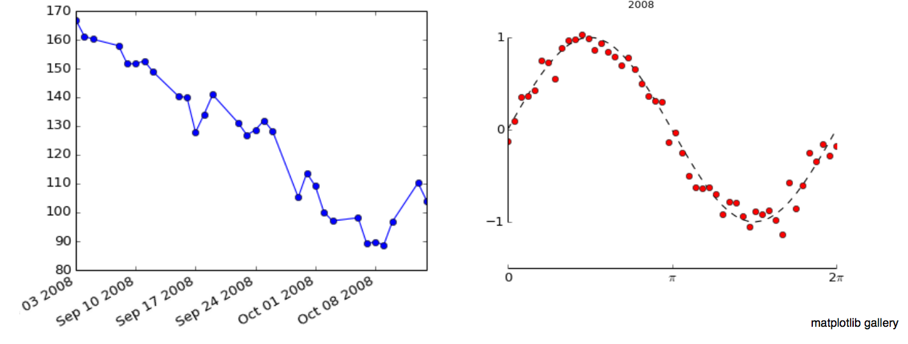
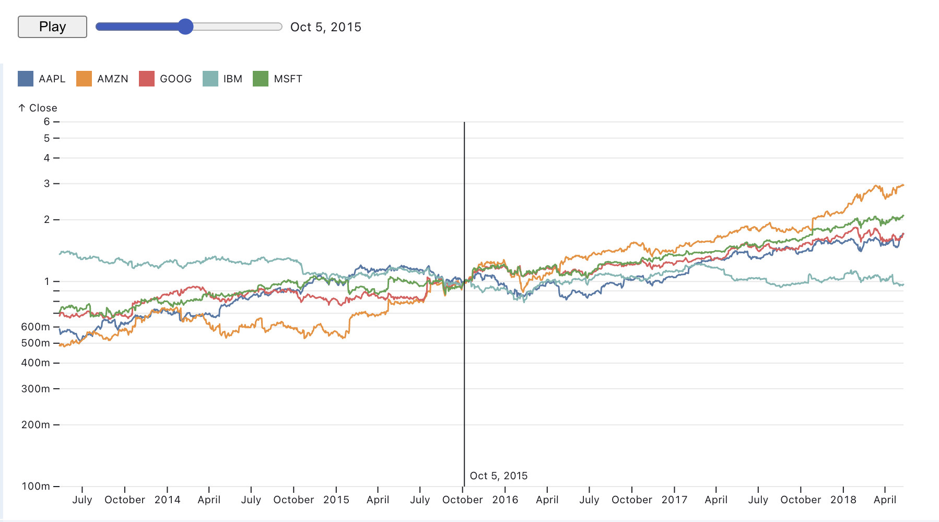
Line chart
Peuvent être combinés avec les scatterplots Données derrivées (index

Slide 8
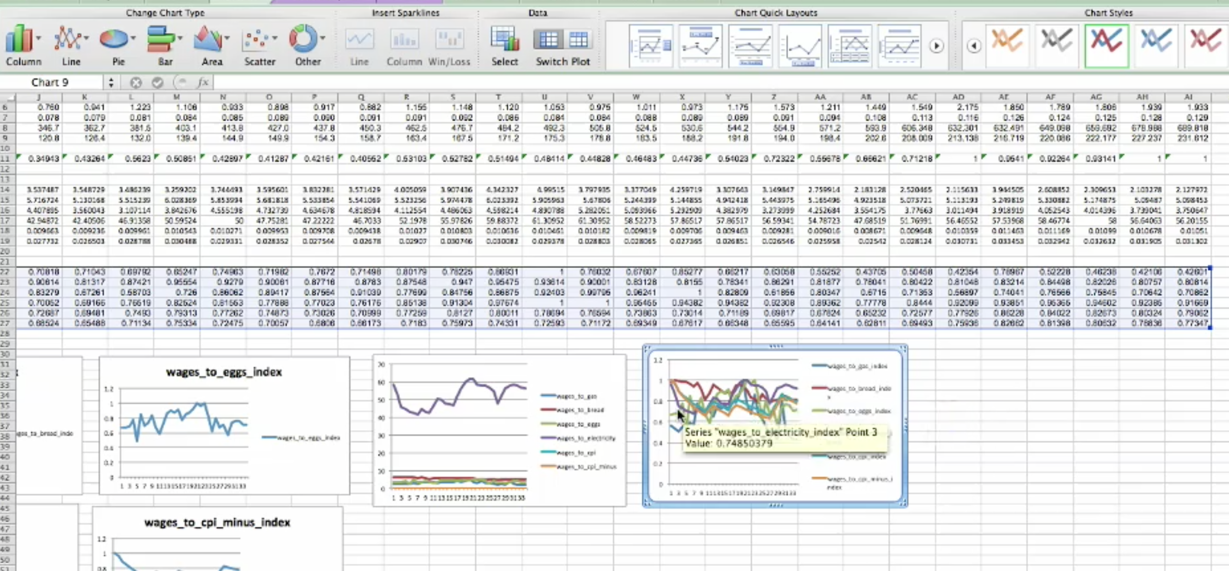
TIME VISUALIZATION: DERIVED DATA
Notes:
https://visualizeit.wordpress.com/2009/06/05/seminal-information-visualization-papers/

Slide 9
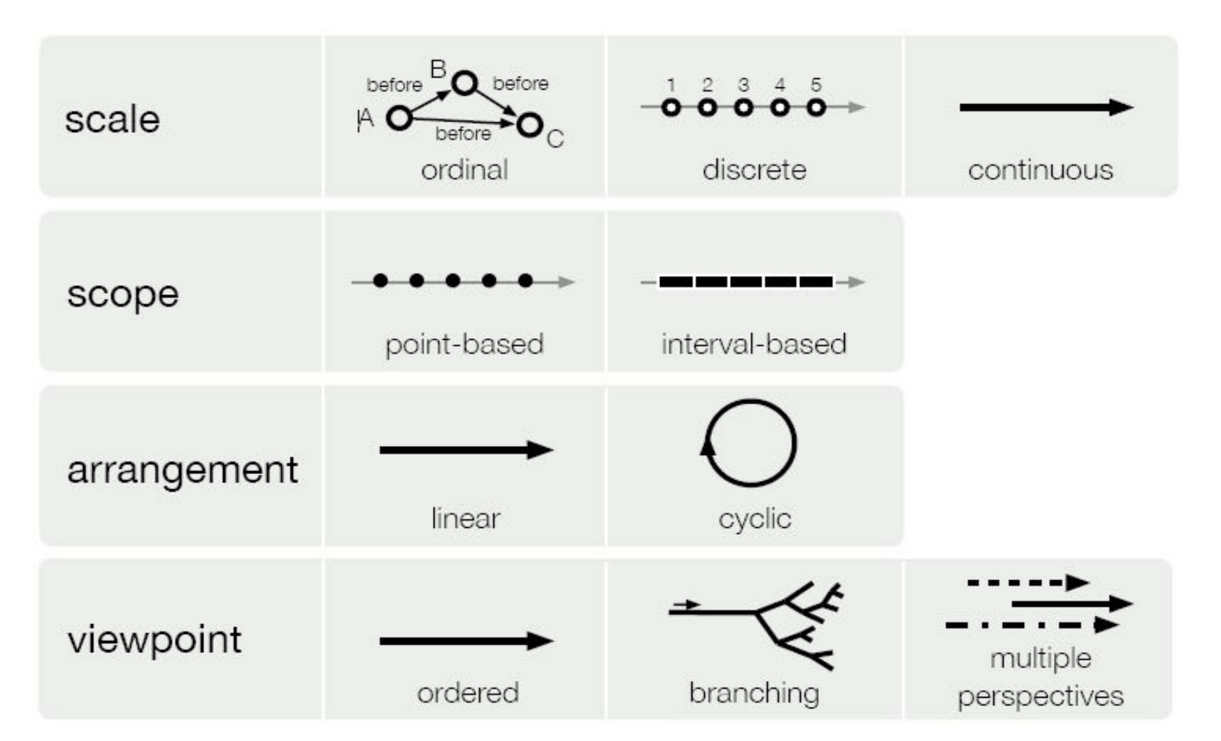
Propriétés des données temporelles
Notes:
http://vda.univie.ac.at/Teaching/Vis/15s/LectureNotes/15_TimeVis_Aigner.pdf

Slide 10
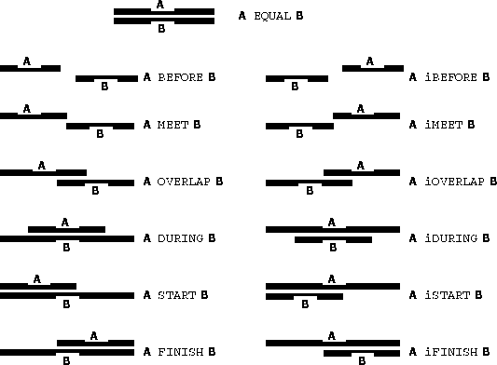
Propriétés des données temporelles : intervalles
Notes:
Allen, J. F. Towards a general theory of action and time. Artificial Intelligence 23 (1984), 123--154.

Slide 11
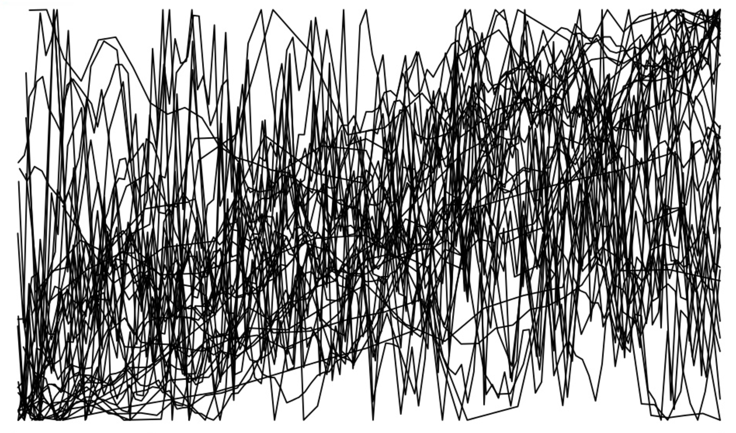
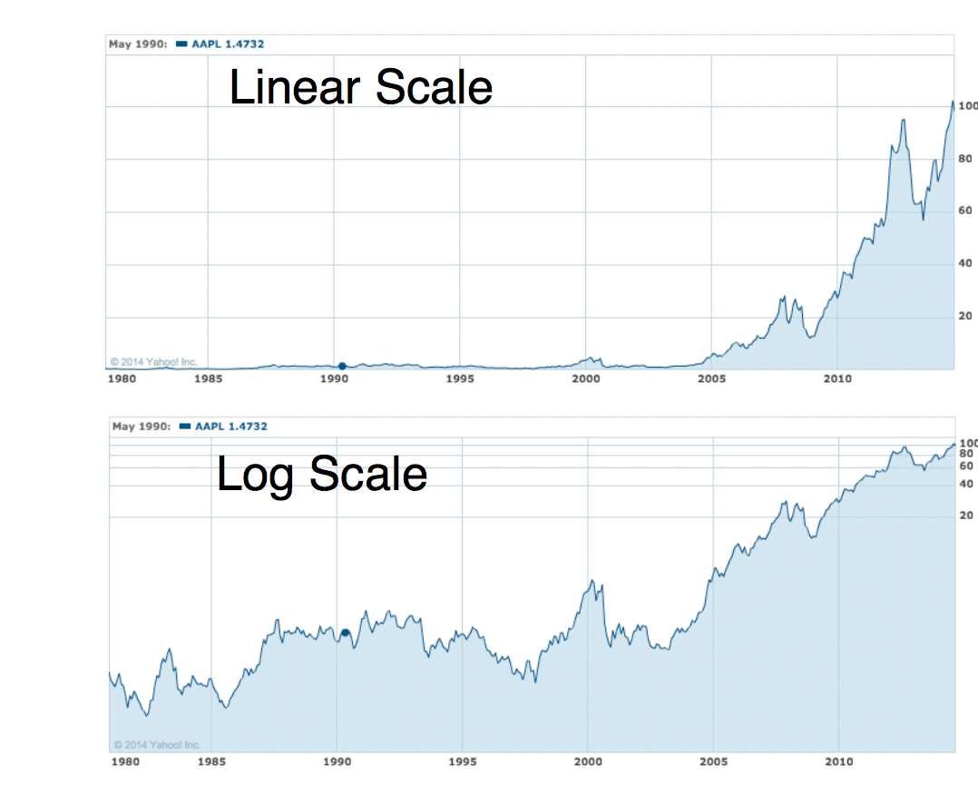
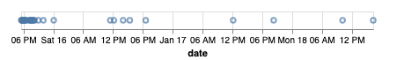
Problème de distribution

Slide 12
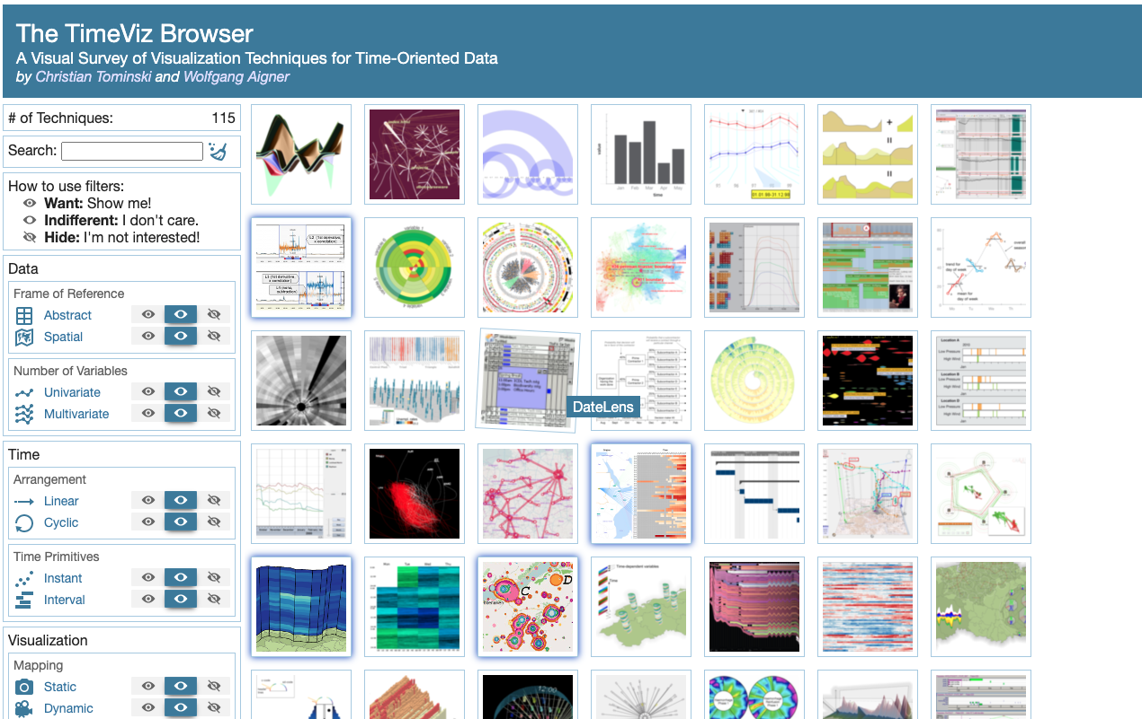
Espace de design très large
https://vcg.informatik.uni-rostock.de/~ct/timeviz/timeviz.html

Slide 13
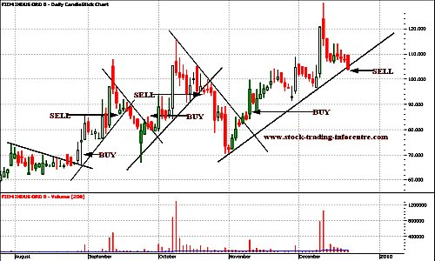
Visualisation de séries temporelles financières
http://www.stock-trading-infocentre.com/trend-line-break2.html

Slide 14
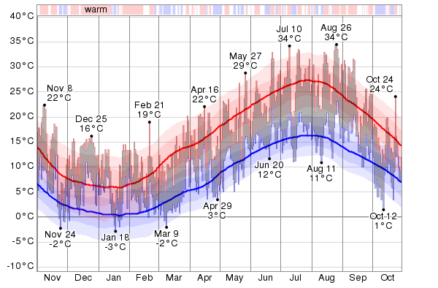
TIME VISUALIZATION
https://weatherspark.com/history/32098/2016/Lyon-Rhone-Alpes-France

Slide 15
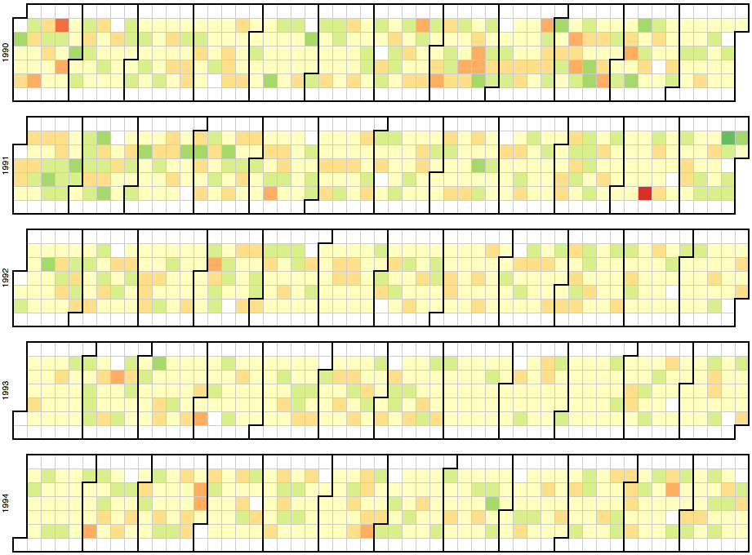
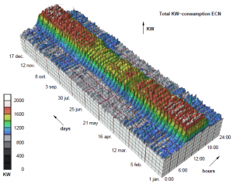
TIME VISUALIZATION: 3D & CALENDAR MAP

Slide 16
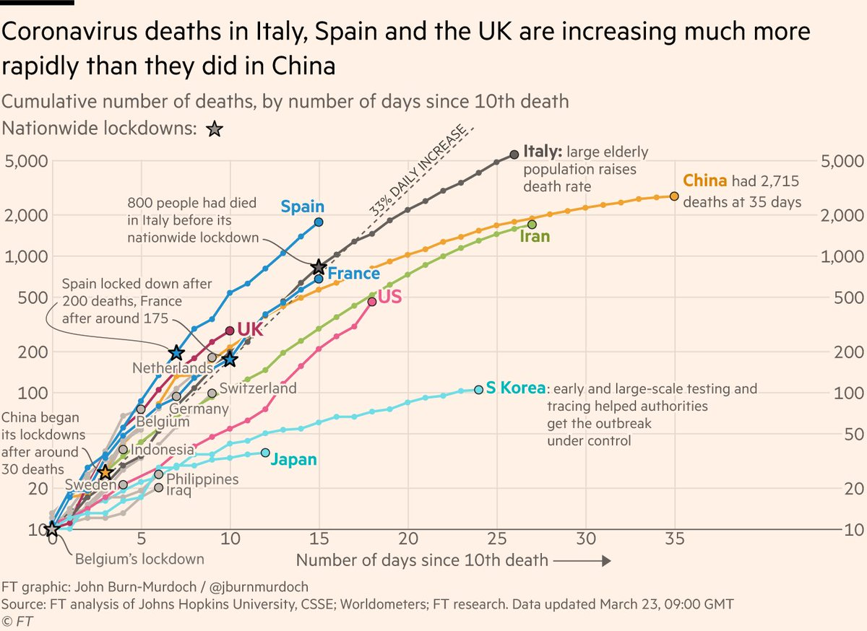
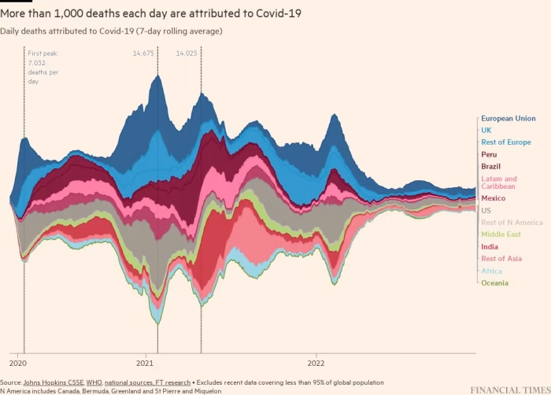
Covid

Slide 17
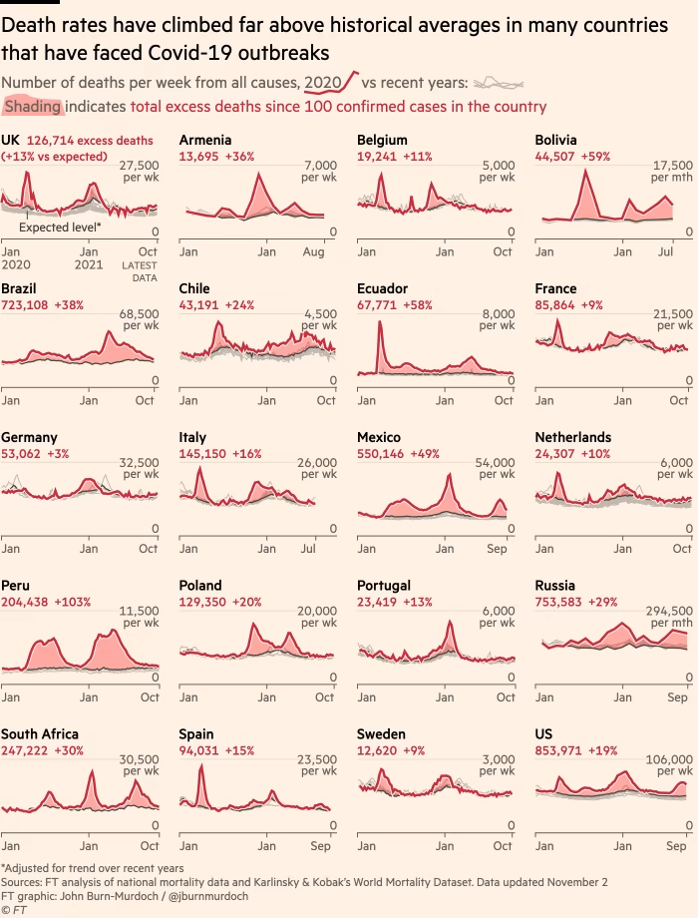
Covid

Slide 18
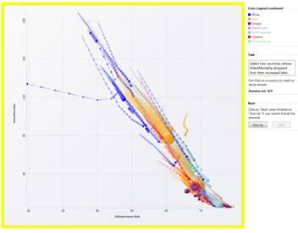
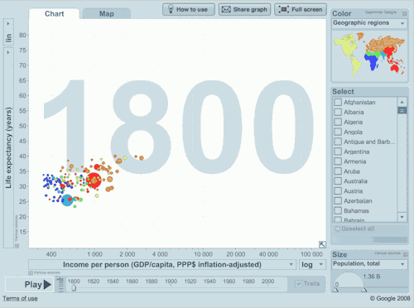
TIME VISUALIZATION: ANIMATION
https://www.youtube.com/watch?v=jbkSRLYSojo

Slide 19
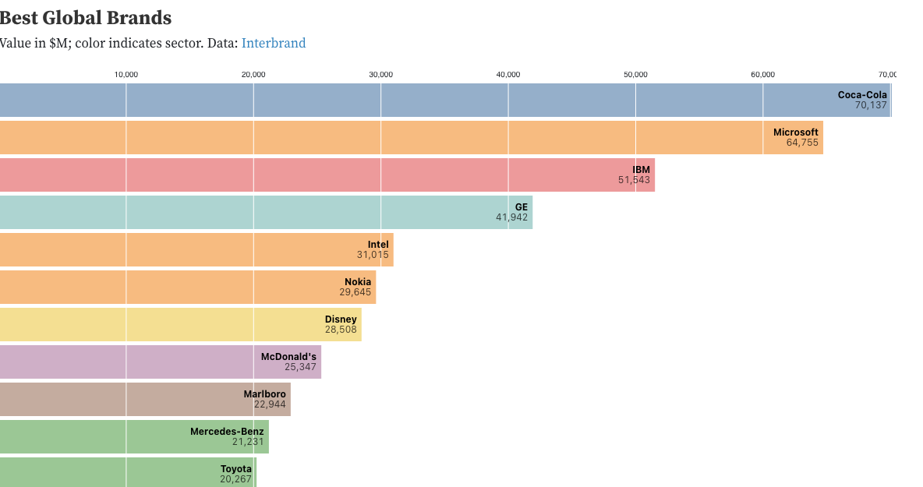
Animer des graphiques standards
https://observablehq.com/@d3/bar-chart-race-explained

Slide 20
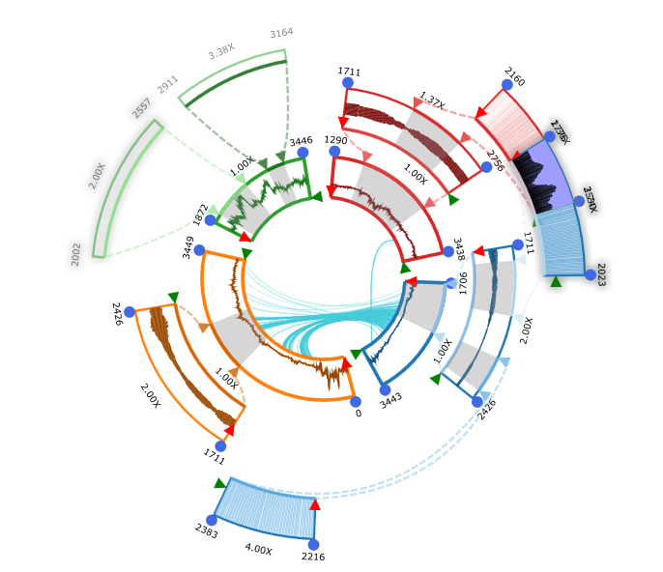
TIME VISUALIZATION: CYCLIC
Notes:
KronoMiner: Using Multi-Foci Navigation for the Visual Exploration of Time-Series Data
https://www.youtube.com/watch?v=U0IN7vfrxi0

Slide 21
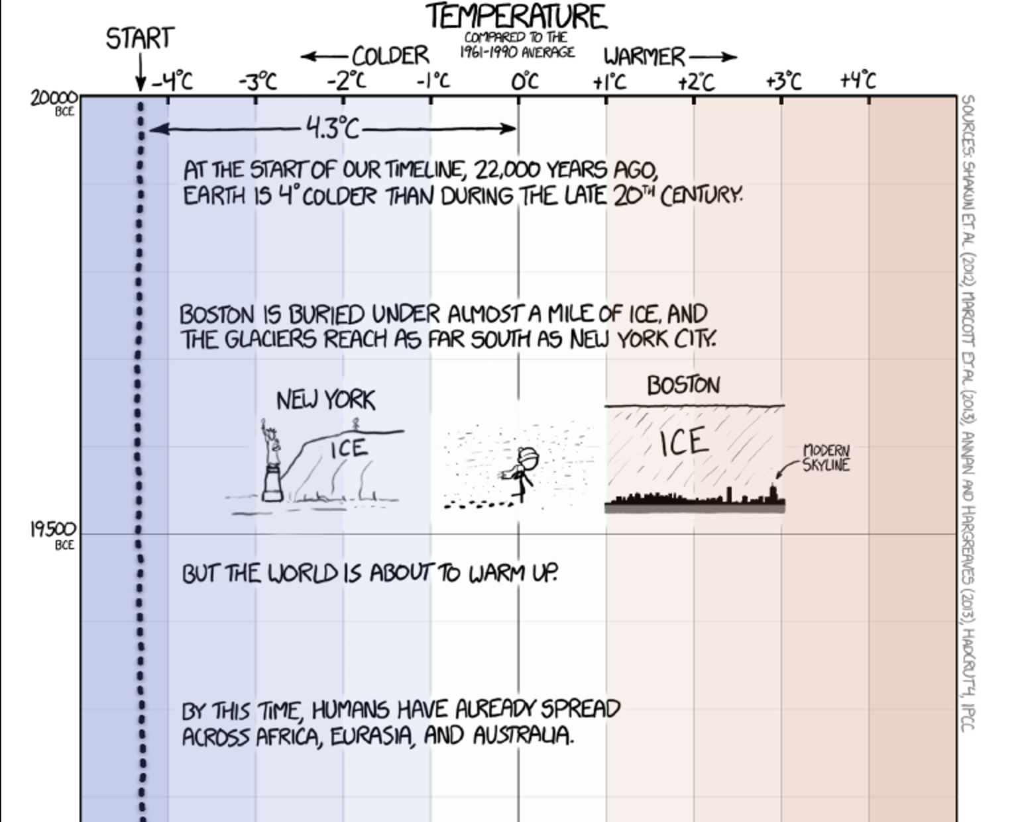
TIME VISUALIZATION: MAGNITUDE
Notes:
http://xkcd.com/1732/

Slide 22
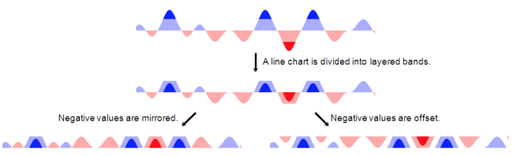
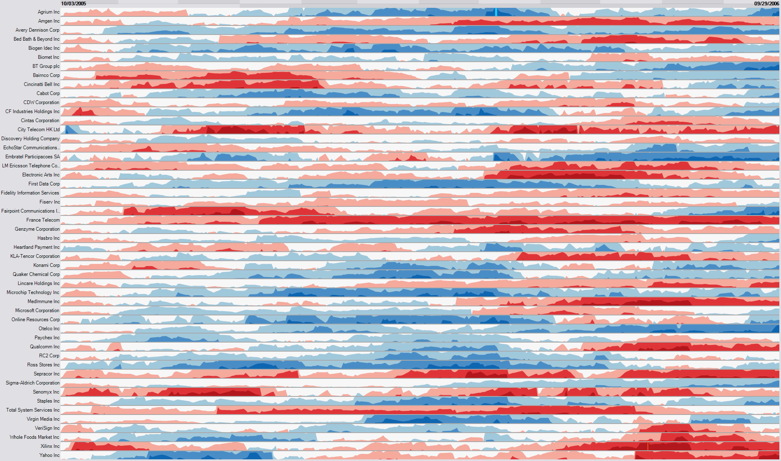
TIME VISUALIZATION: HORIZON GRAPH
http://charlesperin.net/projects/ihg

Slide 23
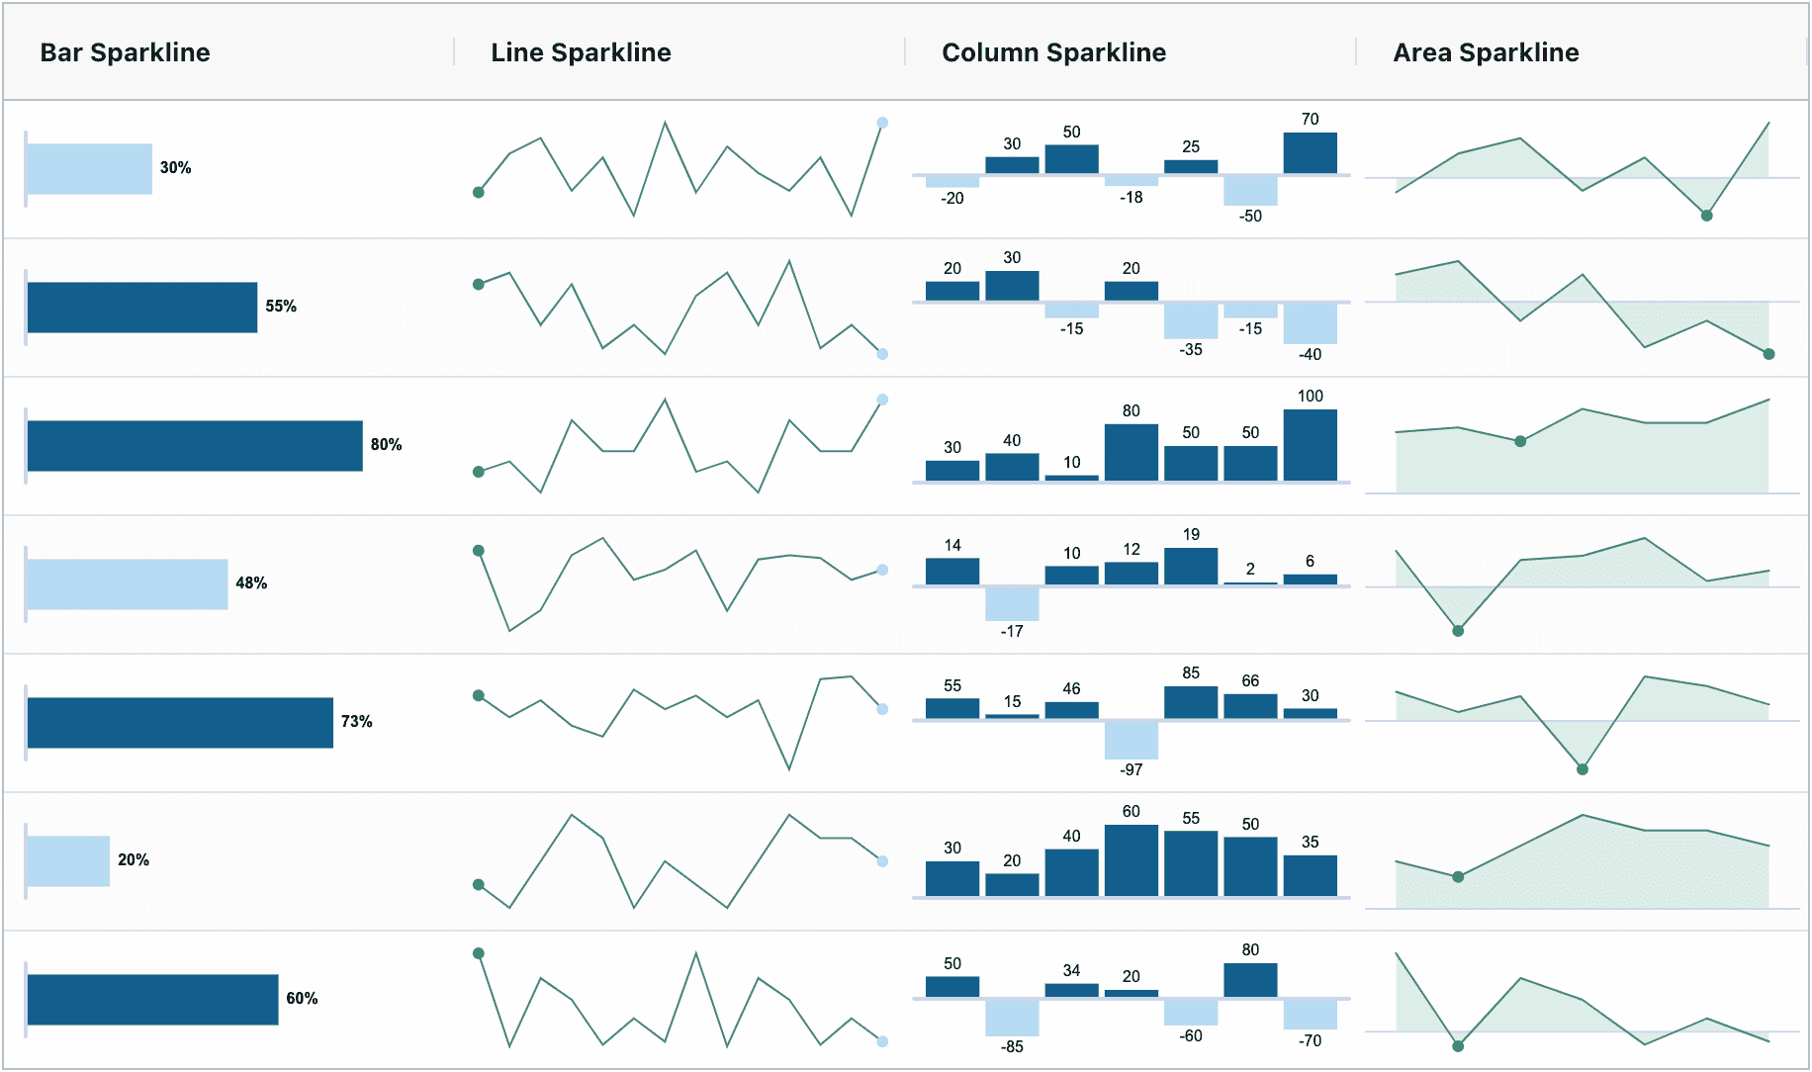
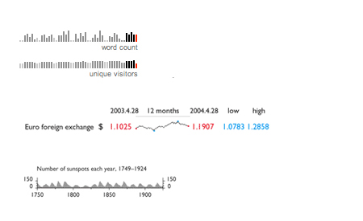
Sparklines

Slide 24
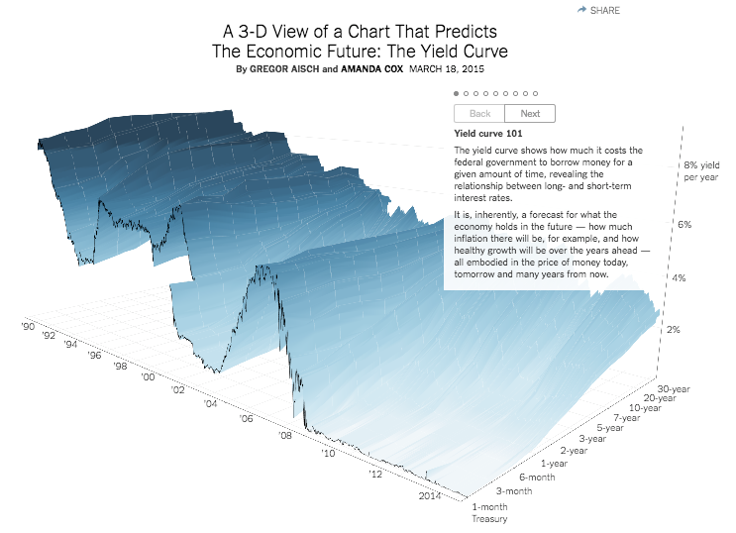
TIME VISUALIZATION: LARGE SCALE
https://www.nytimes.com/interactive/2015/03/19/upshot/3d-yield-curve-economic-growth.html?mcubz=3

Slide 25
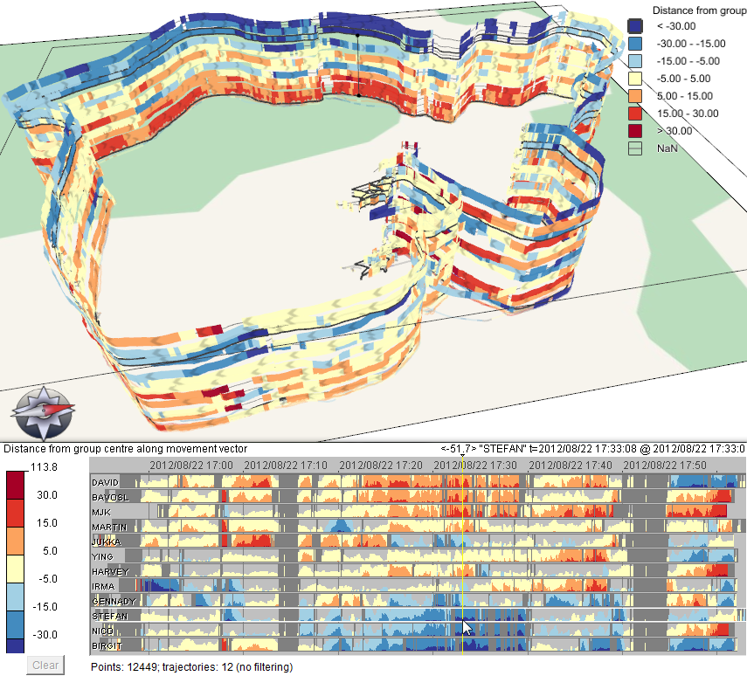
TIME VISUALIZATION: SPACE & TIME

Slide 26
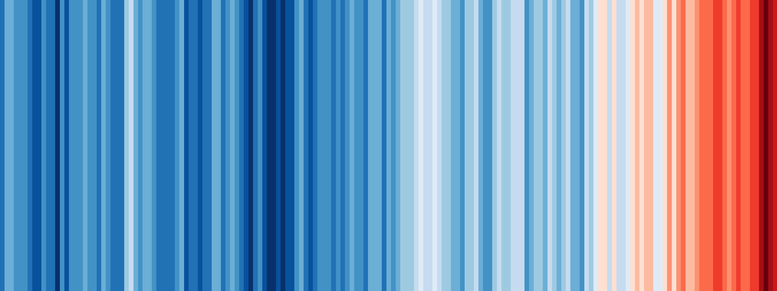
CASE STUDY: CLIMATE VISUALIZATION
LIEN

Slide 27
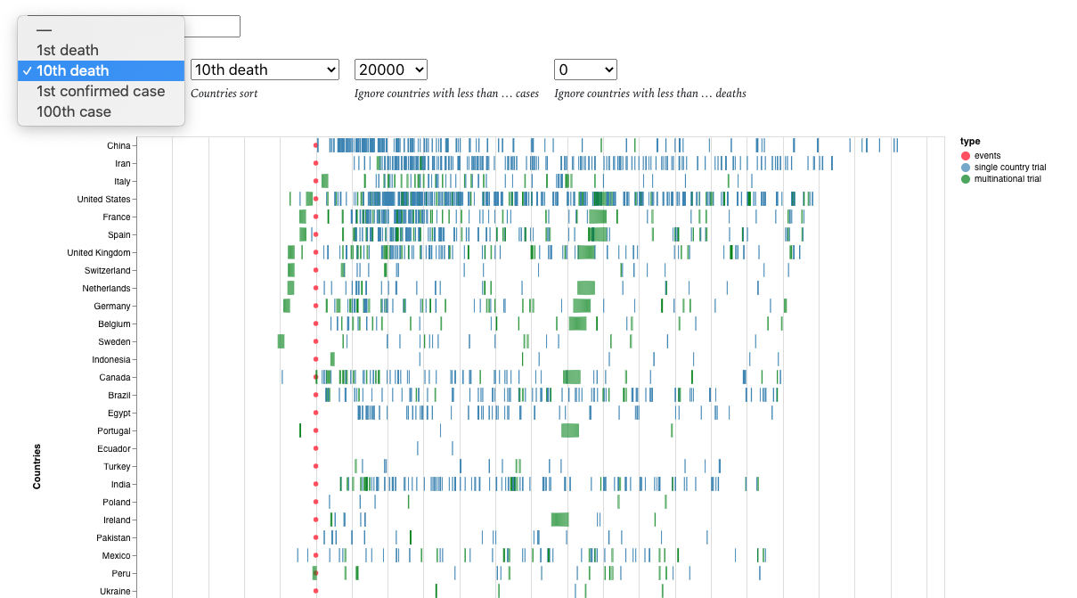
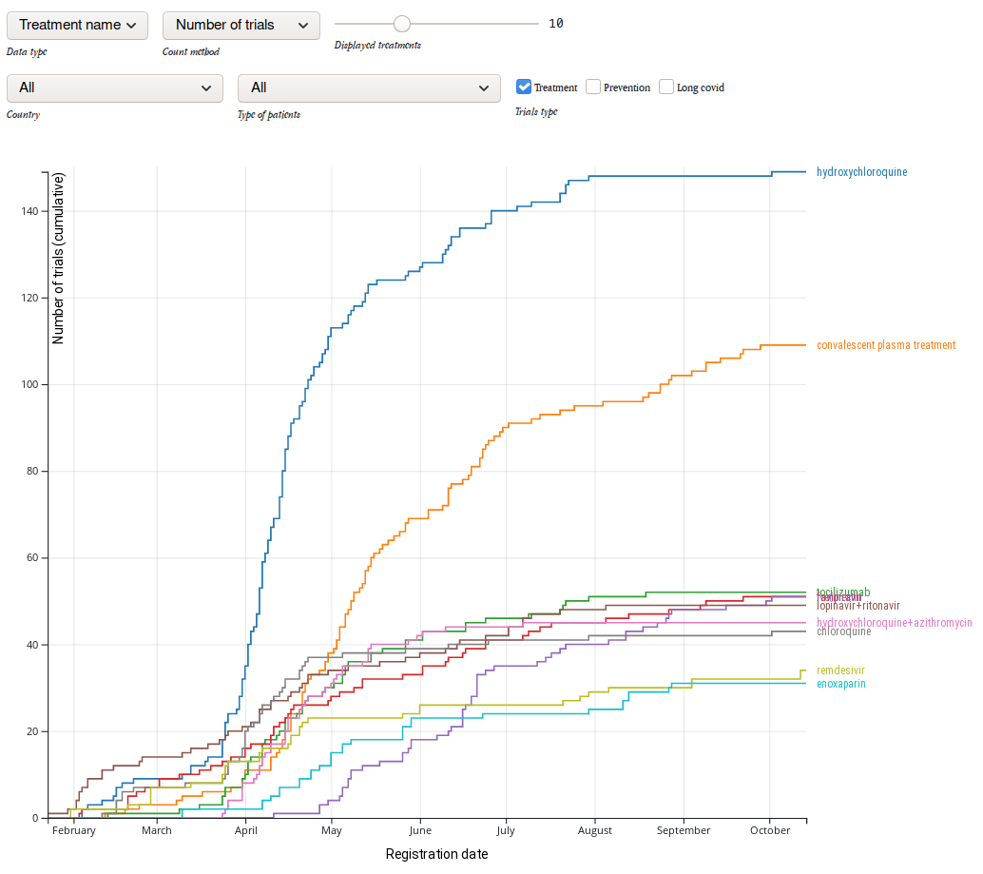
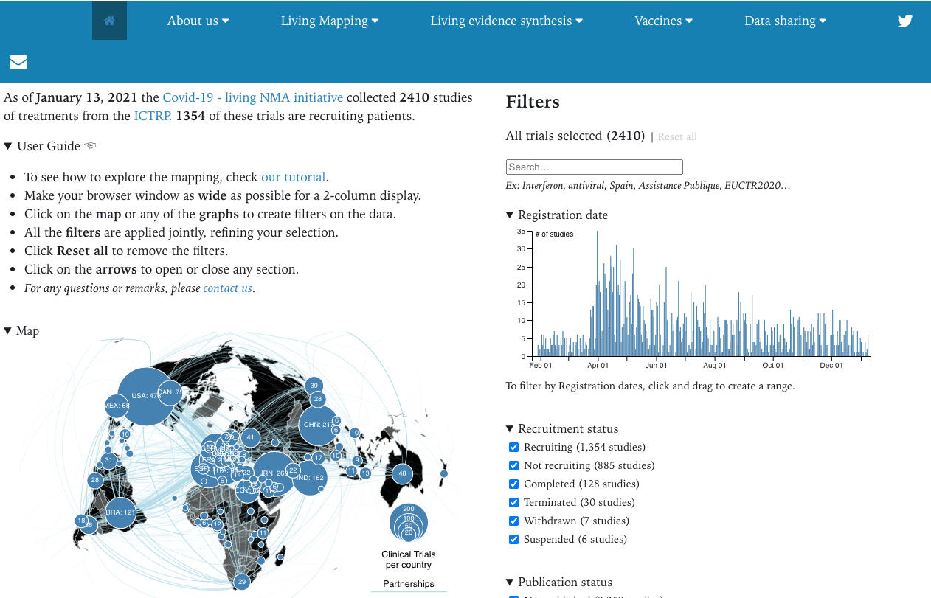
CASE STUDY: COVID-19 DATA
LI EN
https://covid-nma.com/dataviz/

Slide 28
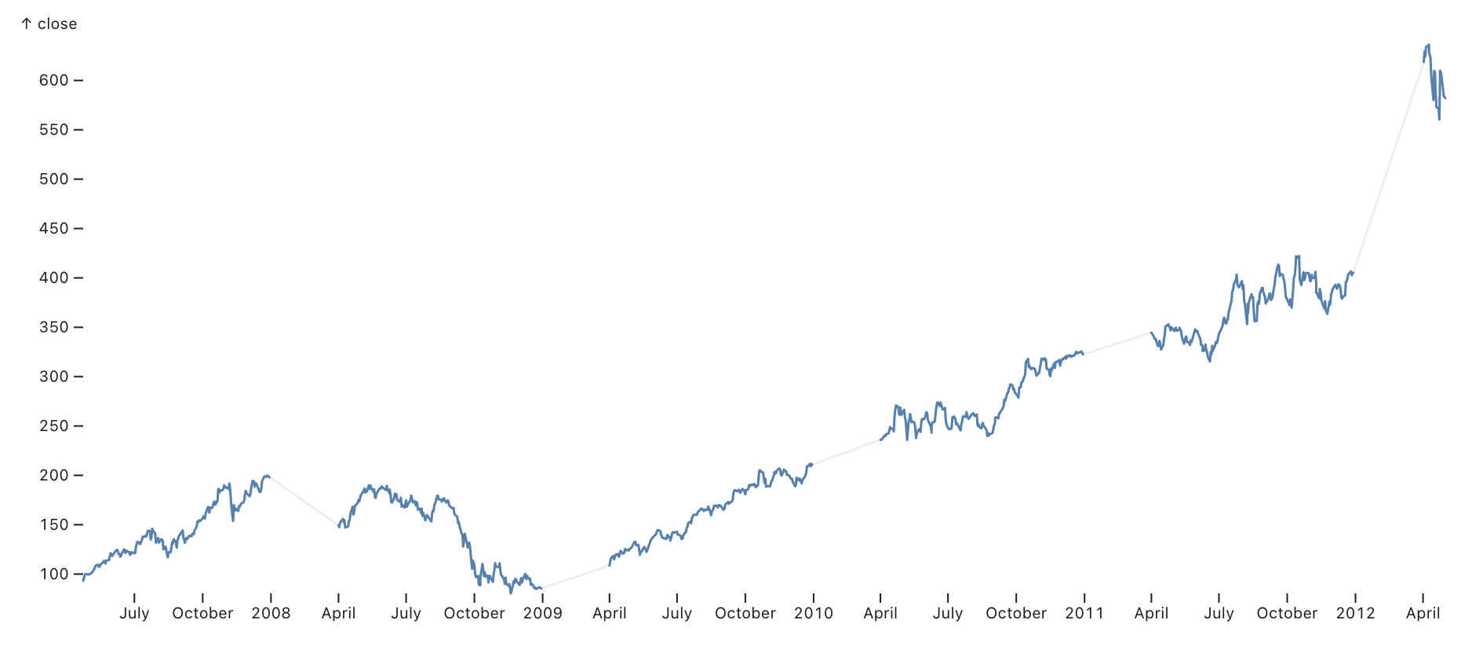
Attention : les données temporelles peuvent manquer..
https://observablehq.com/@ee2dev/line-charts-a-collection-of-plot-examples

Slide 29
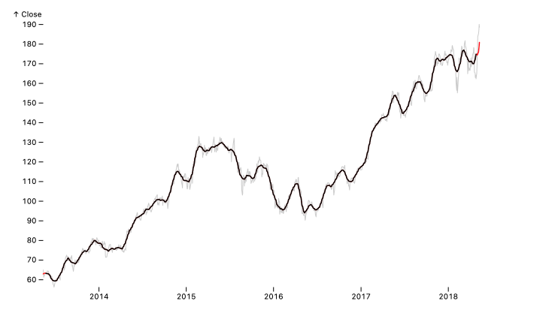
Attention : les données temporelles peuvent être lisées..
https://observablehq.com/@observablehq/plot-window

Slide 30
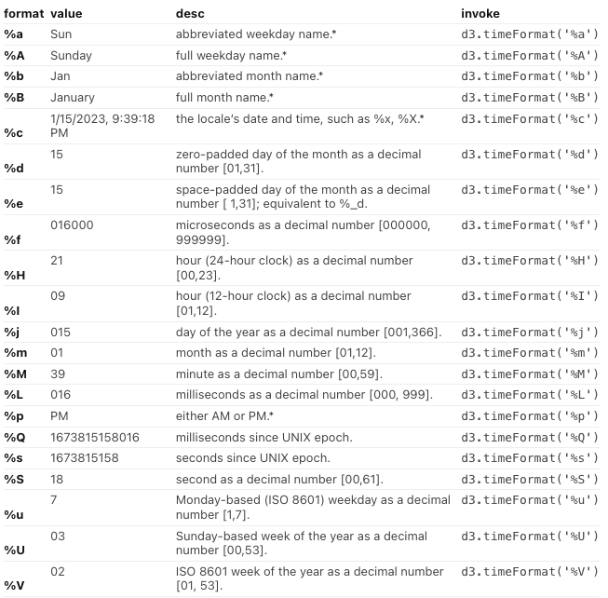
Attention : les données doivent être parsées et groupées
https://observablehq.com/@bumbeishvili/d3-timeformat-playground
D3. timeParse D3.timeFormat

